Slide 1


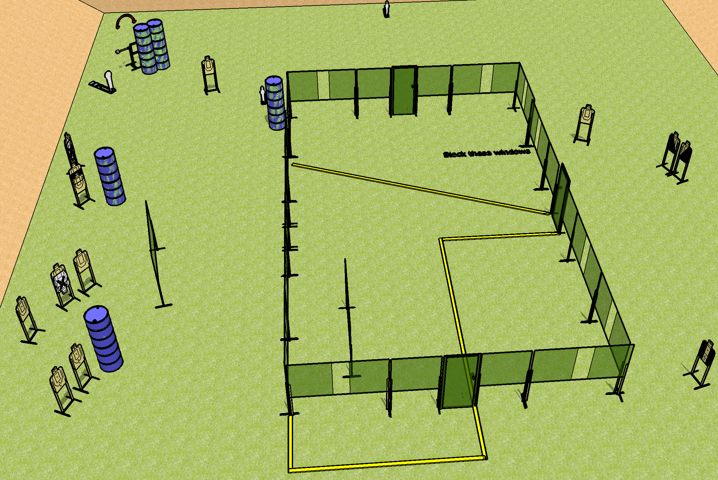
 | Dothan Gun Club – USPSA Match Don’t Shoot the House Course Designer : Drew Coleman
Round Count 31 rounds 14 USPSA 1 Colt, 2 Mini
Equipment List 4 wall feet Swinger 2 medium fault lines 2 diagonal, 1 tuxedo, 1 50%
Stacked with 50%

Slide 2
Don’t Shoot the House
Written Stage Briefing
Don’t Shoot the House is a 31 round, 155 point, Comstock course of fire. There are 14 USPSA targets, 1 colt popper, and 2 mini poppers. The best 2 hits on paper will score, and steel must fall to score. The start signal is audible.
The swinger is activated by the colt popper and is visible at rest.
Handgun start position is inside the shooting area, wrists below belt. Handgun is loaded and holstered.
PCC start position is inside the shooting area, stock on belt. Carbine is loaded with safety on.
On start signal, engage targets as they become available from within the shooting area.

